Slide 1
Introduction to Parts of Speech Tagging
Prof.Aruna Malapati

Slide 2
Learning objectives
Define the problem of Parts Of Speech tagging (POS)
Challenges while POS tagging
Hidden Markov Model

Slide 3
Parts Of Speech Tagging (POS)
Aruna saw the saw.
Annotate each word in a sentence with a part of speech.
NNP
VB
DT
NN

Slide 4
Sequence Data
Till now, we assumed that the data instances are classified independently.
More precisely, we assumed that the data is iid (identically and independently distributed)
In many applications, the data arrives sequentially and the classes are correlated – E.g., weather prediction, speech recognition, activity recognition, etc..

Slide 5
What is the challenge in PoS Tagging?
Tag ambiguous words
Solve the lexical ambiguities
The/DT wind/NN was/VB too/ADV strong/ADJ to/PRP wind/VB the/DT sail/NN.
Tag unknown words
The/DT rural/JJ Babbitt/??? who/WP bloviates/??? about/IN progress/NN and/CC growth/NN

Slide 6
Category of classes
Open: vast number of new members
Nouns, Verbs, Adjectives, Adverbs
Closed: small set of words
Determiners: a, an, the
Pronouns: she, he, i, you, we
Prepositions: on, under, over, near, by,…

Slide 7
Choosing a tagset
Need to choose a standard set of tags to do POS tagging.
Could pick very coarse tagset – N, V, Adj, Adv, Prep.
More commonly used set is finer-grained.
Penn TreeBank II tagset has 36 word tags
PRP, PRP$, VBG,VBD, JJR, JJS …

Slide 8
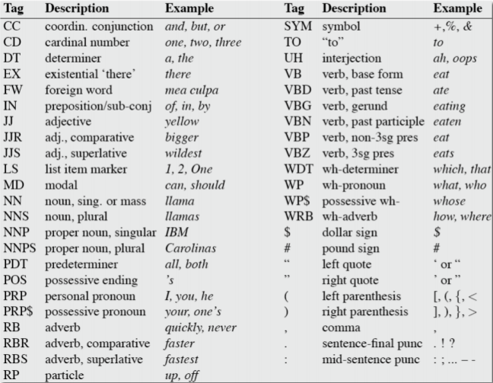
Penn TreeBank PoS Tagset

Slide 9
POS Tagging performance evaluation
Percentage of tags predicted correctly.
Baseline approach: Tag every word with its most common tag and rest of the words are tagged as Noun.

Slide 10
Applications of POS tagging
Text to speech conversion
Useful as a preprocessing step of parsing

Slide 11
Two Methods for PoS Tagging
Rule-based systems
Statistical sequence models
Hidden Markov Models

Slide 12
Discriminative classification models
Given a set of training examples <x_{i},y_{i}> for i=1..m where each x_{i} is the input vector and y_{i} is the class label.
The modeling task as to learn a function f mapping the input x to labels f(x).
The classification models you have learnt till now are discriminative models where each sample input was considered independent of each other.

Slide 13
Generative model for sequence labelling
Given a set of training examples <x_{i},y_{i}> for i=1..m where each x_{i} is the input vector and y_{i} is the class label.
In the POS tagging problem we have
x₁= the dog barks, y₁=DT NN VB
x₂= the boy smiles, y₂=DT NN VB
…..
The task is to learn a function f that maps input x to its corresponding labels f(x).

Slide 14
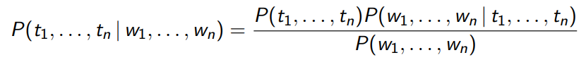
Generative model for sequence labelling
Using Bayes rule
Submodels:
Prior: P(t₁,...,t_{n})
Likelihood: P(w₁,...,w_{n} |t₁,...,t_{n})
Marginal: P(w₁,...,w_{n}) – can be ignored in argmax search

Slide 15
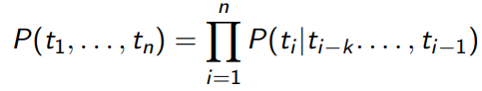
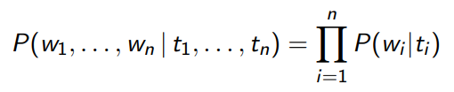
Markov Assumption
Context model (prior)
Lexical model (likelihood)

Slide 16
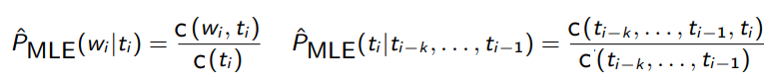
Model Parameters
Contextual probabilities : P(t_{i}|t_{i-k} ,...,t_{i-1})
Lexical probabilities : P(w_{i}|t_{i})
We can estimate these probabilities from a tagged corpus:

Slide 17
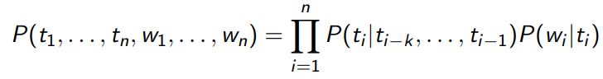
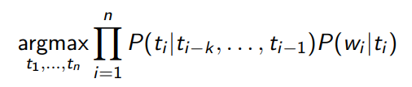
Computing Probabilities
The probability of a tagging:
Finding the most probable tagging:

Slide 18
Two fundamental problems in HMM
Decoding:
How do we compute the best tag sequence given parameters?
Learning:
How do we estimate the parameters?

Slide 19
Example
Given a sentence of length 3, * * the dog barks STOP and the tag sequence * * DT NN VB * then
P(w1 w2 w3,y1,y2,y3) = T(DT|*,*) X T(NN|*,DT) X T(VB|DT NN) X T(STOP|NN VB) X E(*|*) X E(*|*) E(the|DT) X E(dog|NN) X E(barks|VB)X E(STOP|*)
We can also define y₋₁=* and y₀=* as special symbols.

Slide 20
Markov Chains
A Markov chain is a model that tells us something about the probabilities of sequences of random variables, states, each of which can take on values from some set.
A Markov Model is a finite state machine with probabilistic state transitions.
Markov assumption that next state only depends on the current state and independent of previous history.

Slide 21
Markov Chain
Formally, a Markov chain is specified by the following components:
Q = q₁q₂…q_{N} a set of N states | A set of N states
A=a₁₁a₁₂…a_{n1}…a_{nn} | A transition probability matrix A, each a_{ij} representing the probability of moving from state i to state j,
ππ= π₁,π₂,π₃,….,ππ_{n} | An initial probability distribution over states. pi is the probability that the Markov chain will start in state i. Some states j may have pj =0, meaning that they cannot be initial states.
Notes:
A Markov chain is useful when we need to compute a probability for a sequence of observable events.

Slide 22
The Hidden Markov Model
In many cases the events we are interested in are hidden: we don’t observe them directly.
P(t_{i} | t_{i-1}) Transition Probability
NN
VB
DT
NN
initial probability
P(w_{i} | t_{i}) Emission Probability
Aruna
saw
the
saw

Slide 23
HMMs as probabilistic FSA
0.1
DT
NNPS
0.95
0.5
0.9
stop
0.05
VB
0.25
0.1
NNP
0.8
0.4
0.5
0.1
0.25
0.1
start

Slide 24
HMMs as probabilistic FSA
0.1
DT
NNPS
0.95
0.5
0.9
stop
0.05
VB
0.25
0.1
NNP
0.8
0.4
0.5
0.1
0.25
0.1
start
P(NNP VB DT NNPS) = 0.4*0.8*0.25*0.95*0.1=0.0076

Slide 25
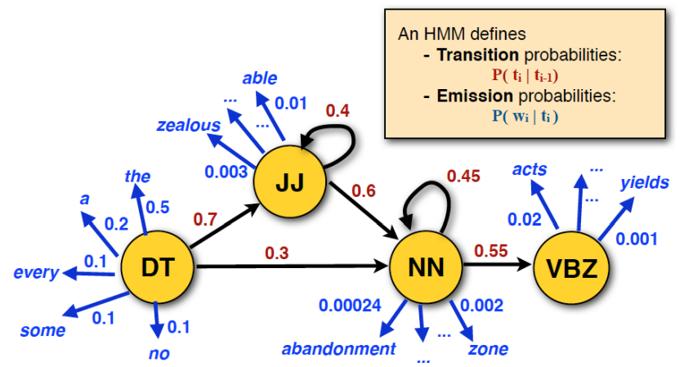
HMMs as probabilistic FSA
Julia Hockenmaier: Intro to NLP

Slide 26
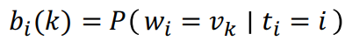
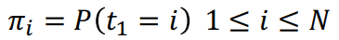
Hidden Markov Models (formal)
States T = t₁, t₂…t_{N};
Observations W= w₁, w₂…w_{N};
Each observation is a symbol from a vocabulary V = {v₁,v₂,…v_{V}}
Transition probabilities
Transition probability matrix A = {a_{ij}}
Observation likelihoods
Output probability matrix B={b_{i}(k)}
Special initial probability vector π

Slide 27
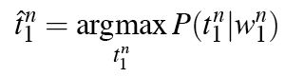
HMM tagging as decoding
HMM model contains hidden variables, the task of determining the hidden variables sequence corresponding to the sequence of observations decoding is called decoding.
Find our best estimate of the sequence that maximizes P(t₁…t_{n}|w₁…w_{n})
Notes:
Out of all sequences of n tags t₁…t_{n} we want the single tag sequence such that P(t₁…t_{n}|w₁…w_{n}) is highest

Slide 28
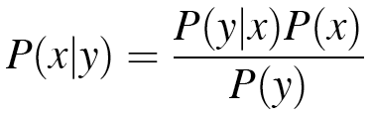
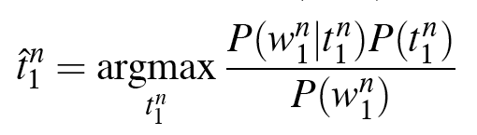
HMM tagging as decoding (Contd…)
Bayes Rule
Drop denominator since is the same for all tags we consider

Slide 29
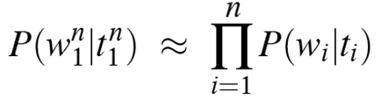
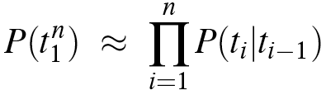
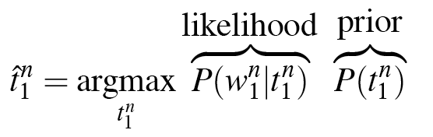
HMM tagging as decoding (Contd…)
A1:P(w) depends only on its own POS
A2:P(t) depends only on P(t-1)

Slide 30
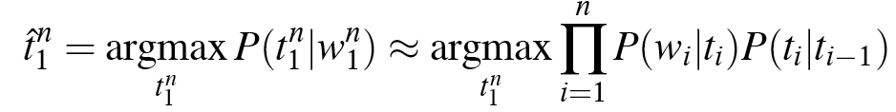
HMM tagging as decoding (Contd…)
Now we have two probabilities to calculate:
Probability of a word occurring given its tag
Probability of a tag occurring given a previous tag
We can calculate each of these from a POS-tagged corpus

Slide 31
Example
Emission Matrix
Tag Translation Matrix
 | * | DT | NNS | VB | NN | IN | STOP
* | 1
the |  | 3/4
employees |  |  | 3/4
pass |  |  |  | 2/4
an |  | 1/4
exam |  |  |  |  | 1
wait |  |  |  | 1/4
for |  |  |  |  |  | 1
employers |  |  | 1/4
fire |  |  |  | 1/4
. |  |  |  |  |  |  | 1
SECOND TAG
 | * | DT | NNS | VB | NN | IN | STOP
* |  | 2/3 | 1/3
DT |  |  | 2/4 | 1/4 | 1/4
NNS |  |  |  | 3/4 |  |  | 1/4
VB |  | 1/4 | 1/4 |  |  | 1/4 | 1/4
NN |  |  |  |  |  |  | 1
IN |  | 1
STOP
F
R
I
S
T
T
A
G
S1: the Employees pass an exam .
T1: DT NNS VB DT NN STOP
S2: the employees wait for the pass .
T2: DT NNS VB IN DT VB STOP
S3: employers fire employees .
T3: NNS VB NNS STOP

Slide 32
Transition diagram
NNS
NN
STOP
*
DT
VB
IN
Tag Translation Matrix
SECOND TAG
 | * | DT | NNS | VB | NN | IN | STOP
* |  | 2/3 | 1/3
DT |  |  | 2/4 | 1/4 | 1/4
NNS |  |  |  | 3/4 |  |  | 1/4
VB |  | 1/4 | 1/4 |  |  | 1/4 | 1/4
NN |  |  |  |  |  |  | 1
IN |  | 1
STOP
F
R
I
S
T
T
A
G

Slide 33
The intuition behind Viterbi
Finding the most probable tagging sequence for a test sentence <w₁ w₂ w₃..,w_{n}>
The argmax is taken over all sequences y₁,y₂,…,y_{n} such that y_{i} Є S for i= 1,2,…n and y_{n+1}=STOP
Lets assume that out tagging model is a bigram model
Notes:
P(t_{i}|t_{i-k},…,t_{i-1})P(w_{i}|t_{i}) is defined by the HMM through the parameters estimated from the training corpus
Now the task we are left with is to find the highest scoring tag sequence under this HMM model for the input sentence <w₁ w₂ w₃..,w_{n}>
S={DT,NNS,VB,}

Slide 34
Brute force search over tag sequences
Input sentence <the employees wait for an exam>
S ={ DT NNS VB IN NN}
All possible tag sequences
DT DT DT DT DT DT STOP
DT DT DT DT DT NNS STOP
DT DT DT DT DT VB STOP
….
Notes:
A critical thing to notice that a brute force through all possible tag sequences is highly inefficient where we enumerate each tag sequence and terms.
Each valid tag sequence has one of the possible Tags from S at each positions followed by the STOP symbol
We can go through each of these tag sequences and evaluate the value of P for each tag sequence and return the highest value.
The problem with this approach is that the number of sequences grows quickly as n increases. In this given input sentence we have 5⁶ possible tag sequences. In general we have |S|^{n} possible sequences.
These grow exponentially as n increases hence this brute force approach is highly inefficient

Slide 35
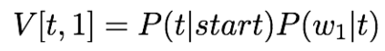
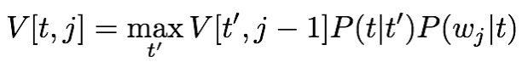
Viterbi algorithm
Create a table V with N+2 rows and T columns:
N – the number of states/tags
T – the length of the sequence/sentence
Initialise the first column
For each tag t in the tagset compute:
For each column j = 2 to T in the table V:
For each tag t in the tagset compute:

Slide 36
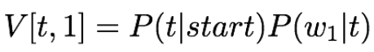
Example
Transition matrix: P(t_{i}|t_{i-1})
Emission matrix: P(w_{i}|t_{i})
 | NOUN | Verb | Det | Prep | ADV | STOP
<S> | .3 | .1 | .3 | .2 | .1 | 0
Noun | .2 | .4 | .01 | .3 | .04 | .05
Verb | .3 | .05 | .3 | .2 | .1 | .05
Det | .9 | .01 | .01 | .01 | .07 | 0
Prep | .4 | .05 | .4 | .1 | .05 | 0
Adv | .1 | .5 | .1 | .1 | .1 | .1
 | a | cat | doctor | in | is | the | very
Noun | 0 | .5 | .4 | 0 | 0.1 | 0 | 0
Verb | 0 | 0 | .1 | 0 | .9 | 0 | 0
Det | .3 | 0 | 0 | 0 | 0 | .7 | 0
Prep | 0 | 0 | 0 | 1.0 | 0 | 0 | 0
Adv | 0 | 0 | 0 | .1 | 0 | 0 | .9
 | w1-=the | w2=doctor | w3=is | w4=in | STOP
Noun | 0
Verb | 0
Det | .21
Prep | 0
Adv | 0
V(Noun,the) = P(Noun|<S>)P(the|Noun) = .3 X 0=0
V(Verb,the) = P(Verb|<S>)P(the|Verb) = .1 X 0=0
V(Det,the) = P(Det|<S>)P(the|Det) = .3 X .7=.21
V(Prep,the) = P(Prep|<S>)P(the|Prep) = .2 X .0=0
V(Adv,the) = P(Adv|<S>)P(the|Adv) = .2 X .0=0

Slide 37
Example (Contd..)
V(Noun, doctor) = max_{t’} V(t’,the)XP(Noun|t′)X P(doctor|Noun)
= max { 0, 0, .21 (.9 X.4), 0, 0 } = .0756
V(Verb, doctor) = max_{t’} V(t’,the)XP(Verb|t′)X P(doctor|Verb)
= max {0, 0, .21(.01X.1)), 0, 0} = .00021
 | w1-=the | w2=doctor | w3=is | w4=in | STOP
Noun | 0 | .0756
Verb | 0 | .00021
Det | .21 | 0
Prep | 0 | 0
Adv | 0 | 0
Notes:
P(Noun Det) -(doctor|Noun =.9(.4)
P(Verb Det) -(doctor|Verb =.01(.1)

Slide 38
Completed Viterbi matrix
 | w1-=the | w2=doctor | w3=is | w4=in | STOP
Noun | 0 | .0756 | .001512 | 0 | .0000272
Verb | 0 | .00021 | .027216 | 0
Det | .21 | 0 | 0 | 0
Prep | 0 | 0 | 0 | .005443
Adv | 0 | 0 | 0 | .000272

Slide 39
Backtracking the Viterbi Matrix
 | w1-=the | w2=doctor | w3=is | w4=in | STOP
Noun | 0 | .0756 | .001512 | 0 | .0000272
Verb | 0 | .00021 | .027216 | 0
Det | .21 | 0 | 0 | 0
Prep | 0 | 0 | 0 | .005443
Adv | 0 | 0 | 0 | .000272
Det Noun Verb Prep

Slide 40
Thank You!

